Slide 1
MIS 6346.502- Big Data TRUCK GEOLOCATION AND RISK FACTOR
GROUP 7
Viren Shashikant Chauhan
Radhika Dubey
Parth Hareshbhai Gabani
Jogendra Prasad Gali
Chinmay Hebbal
Yating Huang
Jaan Ashok Kesawalekar

Slide 2
Problem statement and Objectives
Transportation by the means of roadways by using Trucks is popular mode in the United States and there have been substantial rise in the events caused due to them
Our objective here is to help ANT to identify the risky drivers by exploring, analyzing and visualizing the relevant data
We aim to analyze other potential risk factor to have a better understanding of the risks:
Risky truck models
Risky events frequency
Cities/location where events occur frequently

Slide 3
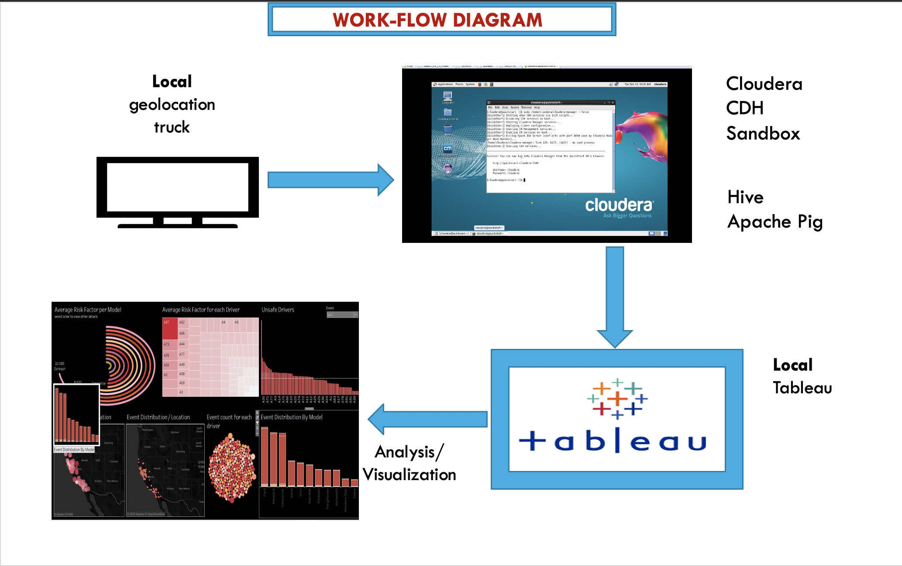

Slide 4
Table created and operations performed
Table Name | Type | Operation Performed
Geolocation | Base | HDFS to Hive using INPATH
Trucks | Base | HDFS to Hive using INPATH
avg_mileage | Transform | Hive Query
driver_mileage | Transform | Hive Query
truck_mileage | Transform | Hive Query
riskfactor | Transform | PIG Script

Slide 5
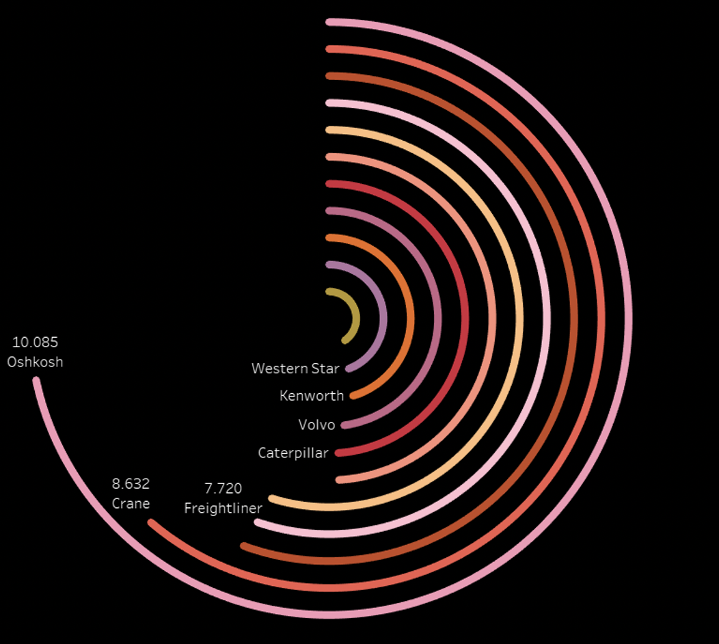
Average risk factor per model

Slide 6
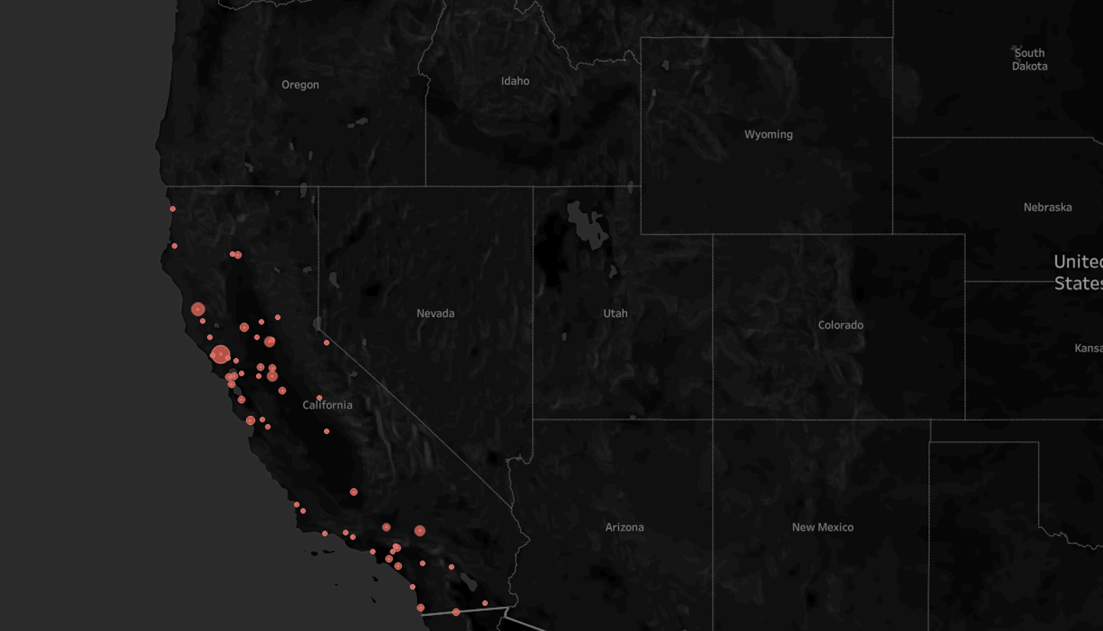
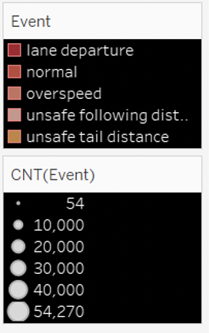
Event distribution/Location

Slide 7
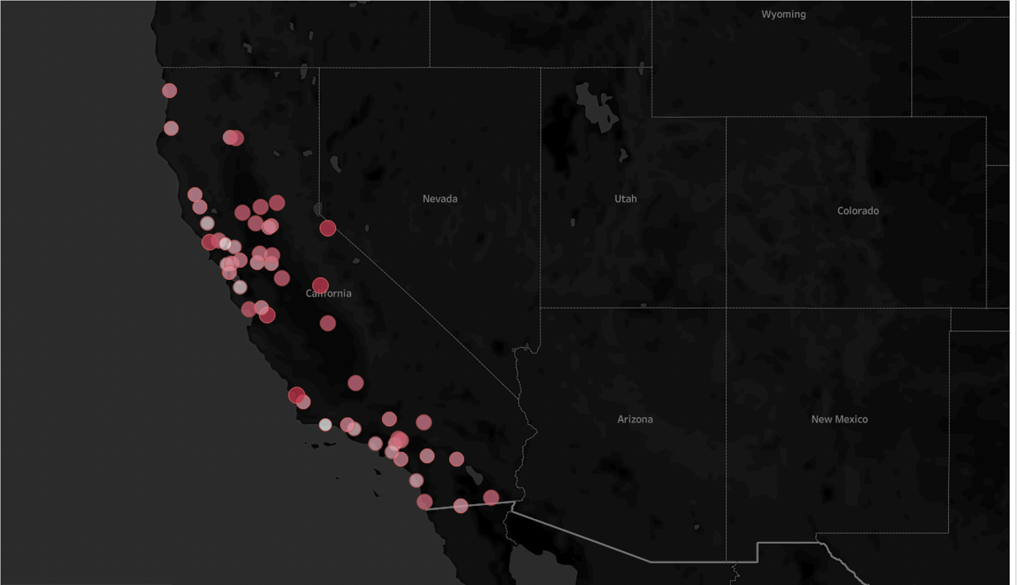
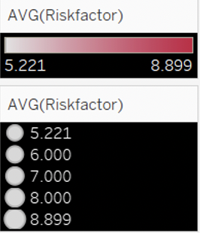
Average risk per location

Slide 8
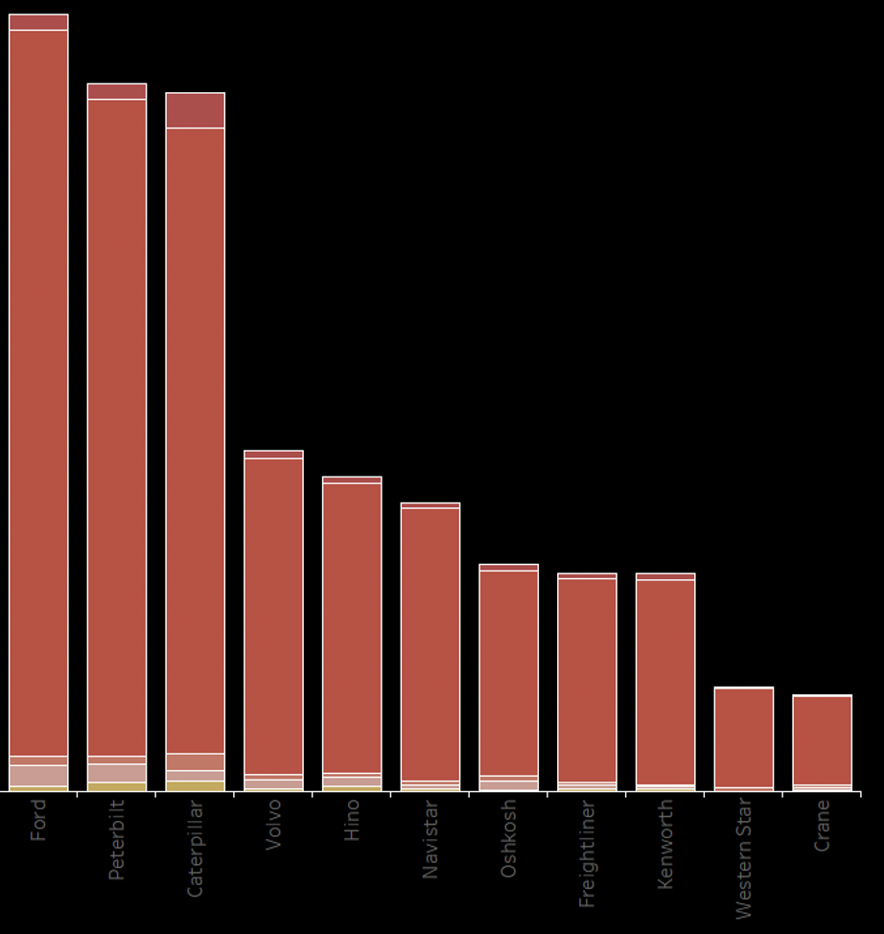
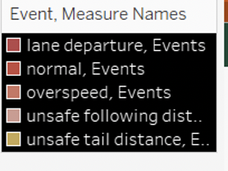
Event distribution by Model

Slide 9
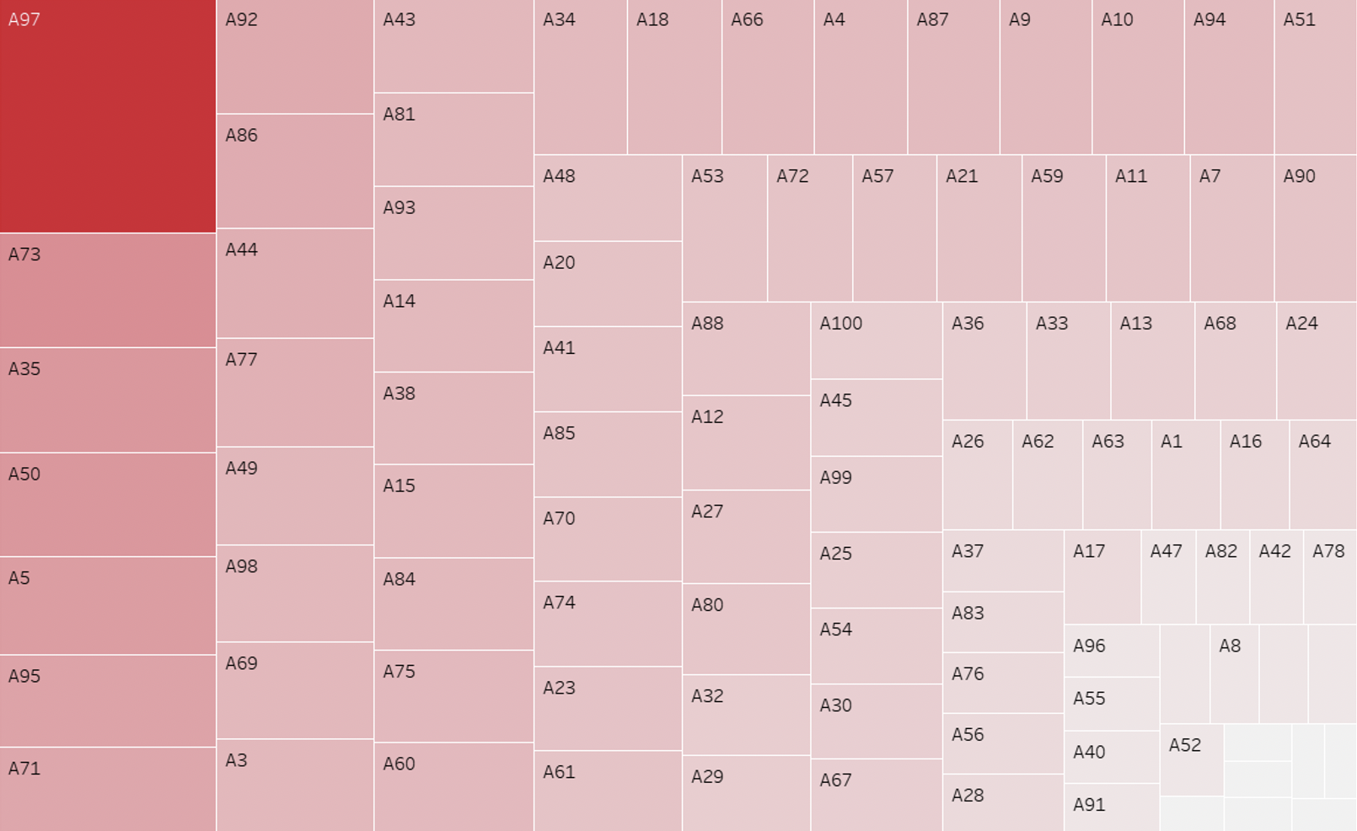
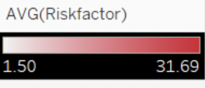
Average risk factor for each Driver

Slide 10
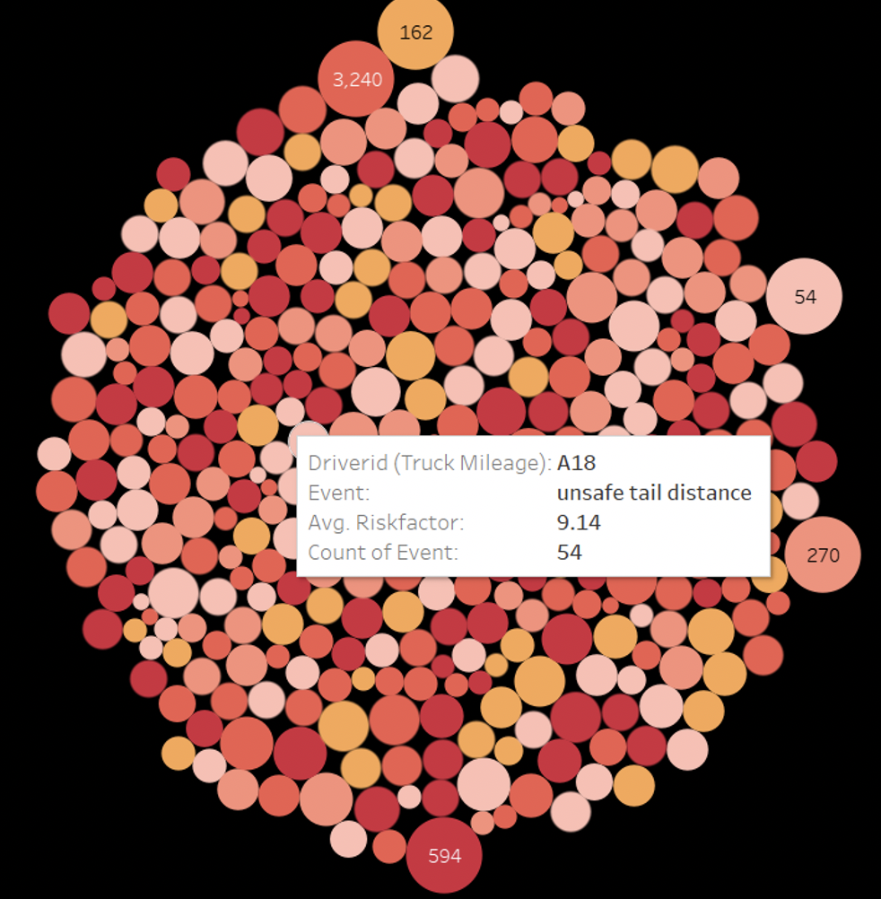
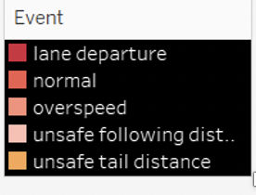
Event count for each driver

Slide 11
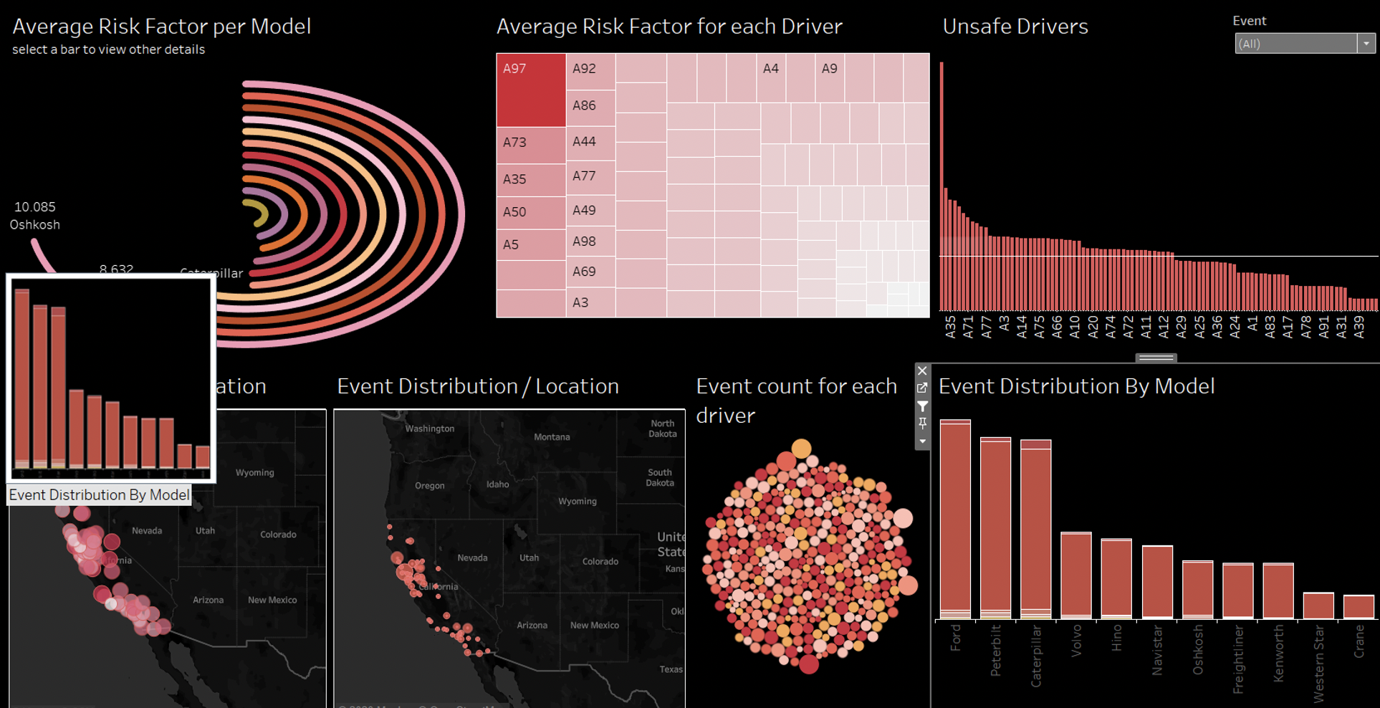

Slide 12
Thank You

